Slide 1
WELCOME TO EUREKA! Get your books for Summer & Online Jumpstart Courses https://bncvirtual.com/eureka
Contact the Bookstore at bookstore@eureka.edu if you have any questions

Slide 2
SOME HELPFUL INFORMATION BEFORE YOU CLICK THE LINK:
Click lets get started
Choose your course from drop down box
Arrow to view your materials
Select your books and proceed to check-out
Set up an account (this will be used each semester)
Choose to ship to your home address and shipping method
Pay with credit card, Paypal or your student account. You will need the access number sent to you from MBS Books.
Make sure you submit your order. You should receive an email confirmation.
https://bncvirtual.com/eureka

Slide 3
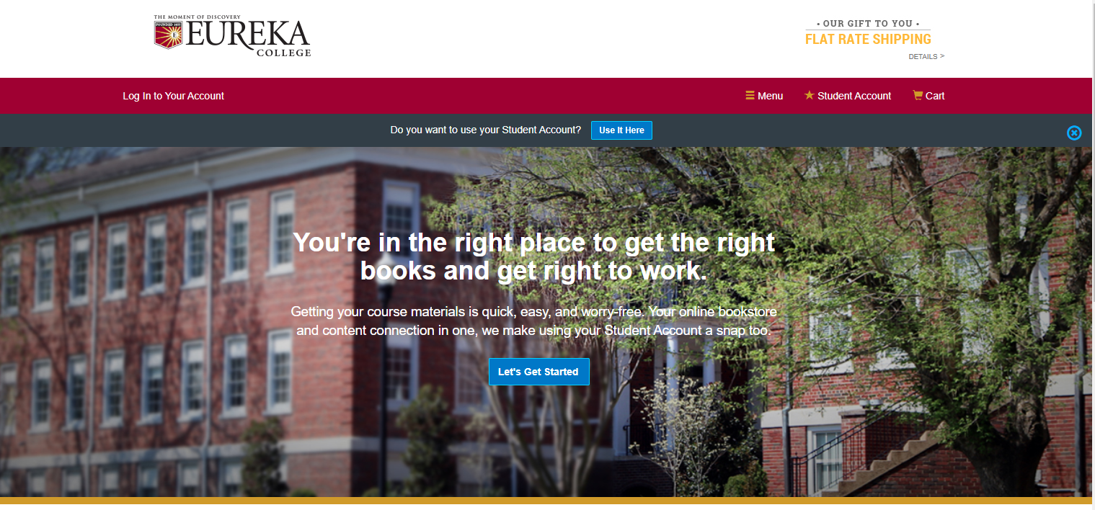

Slide 4
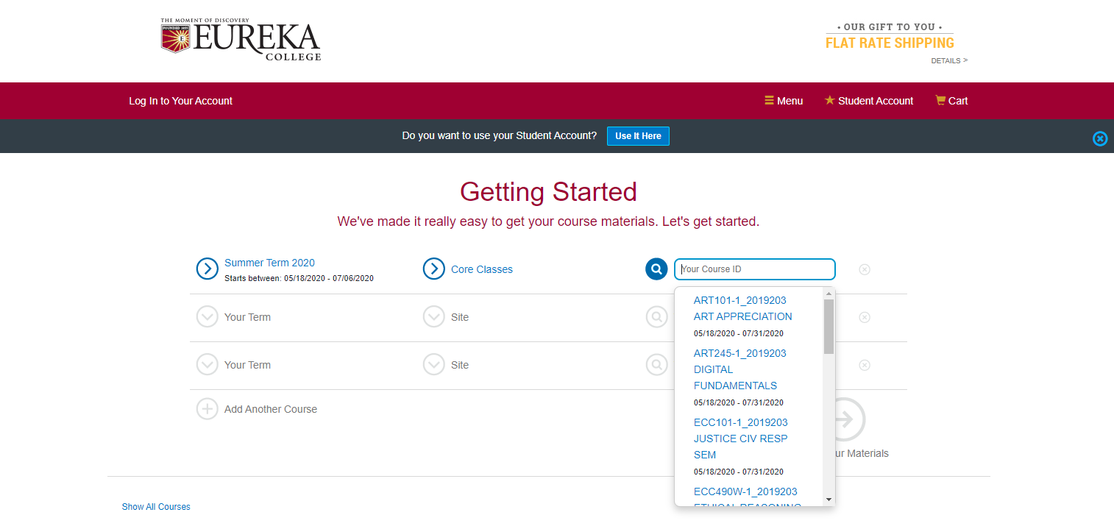

Slide 5
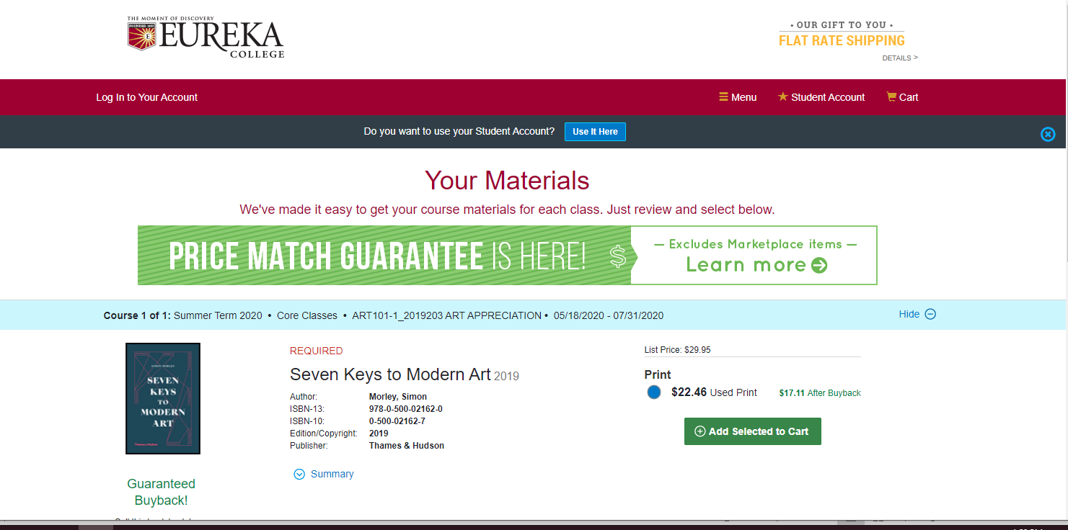

Slide 6
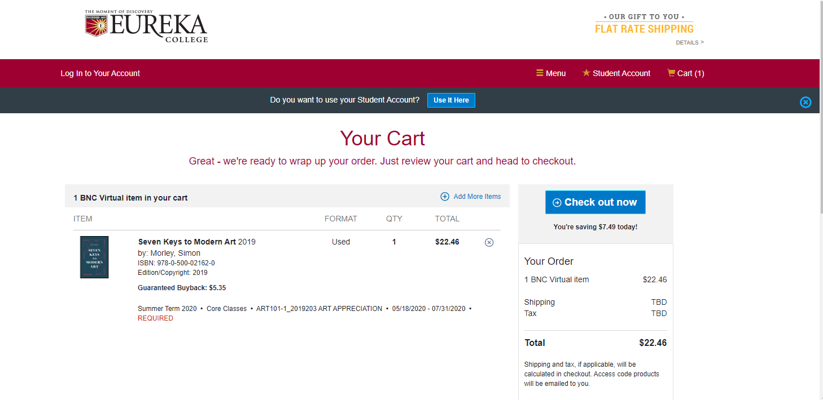

Slide 7
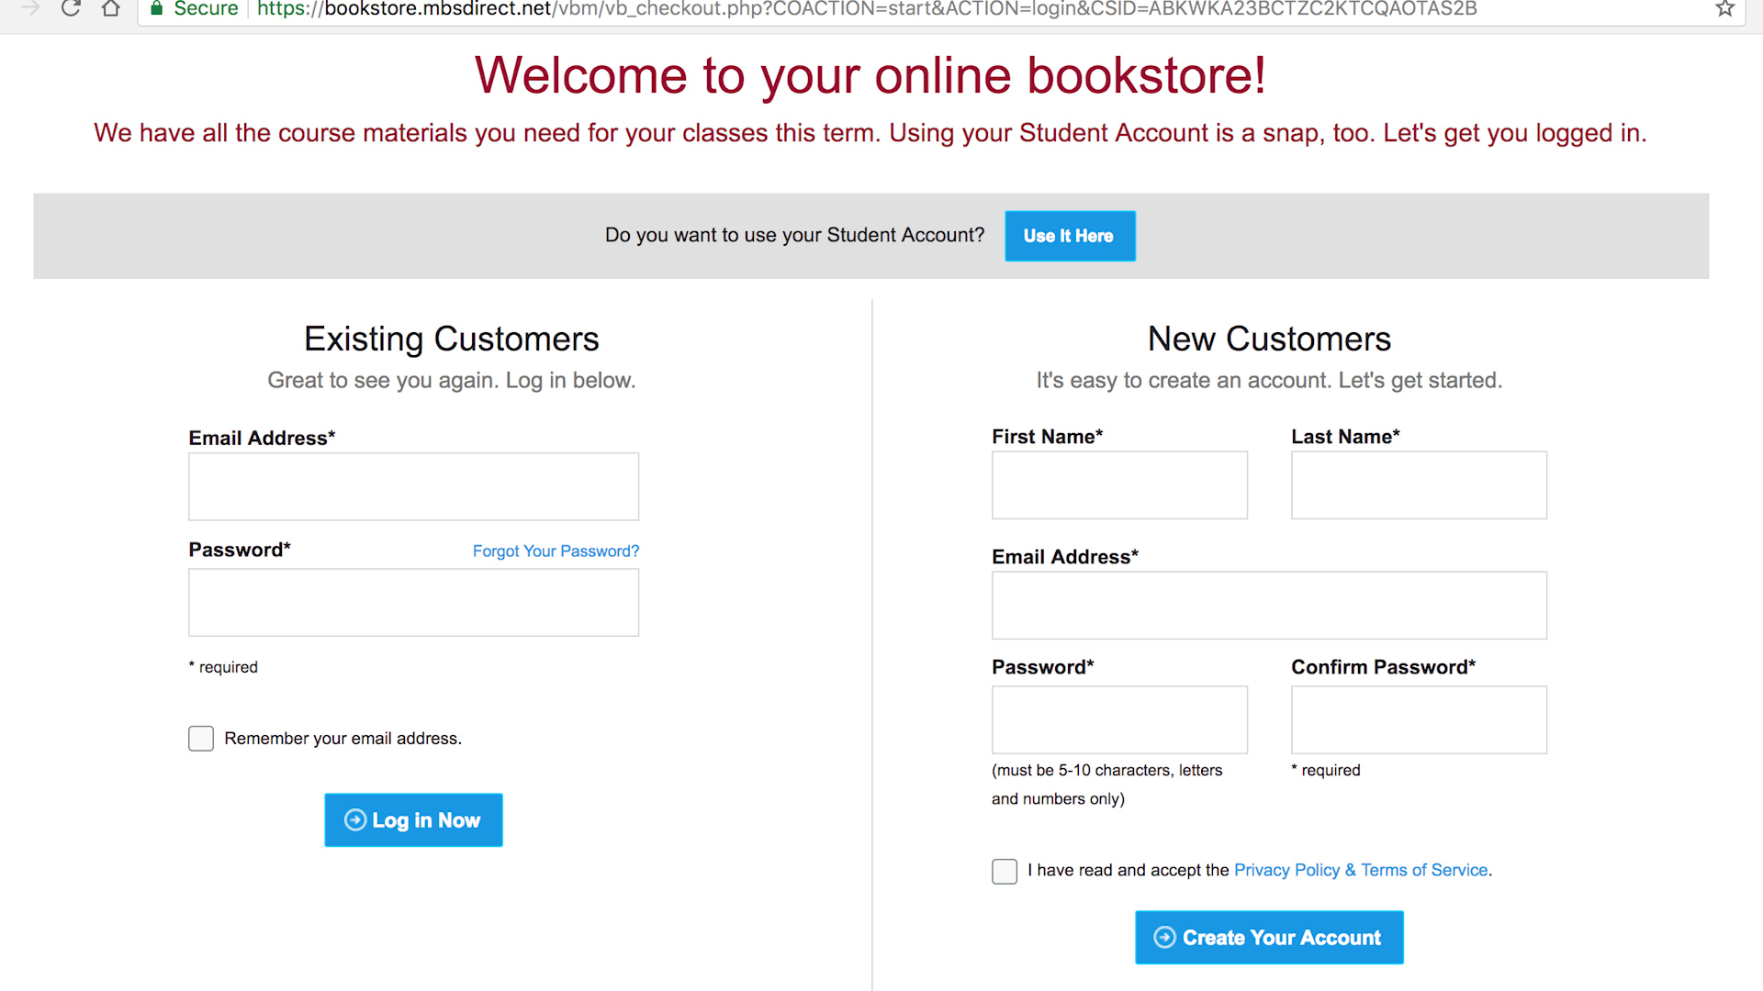

Slide 8
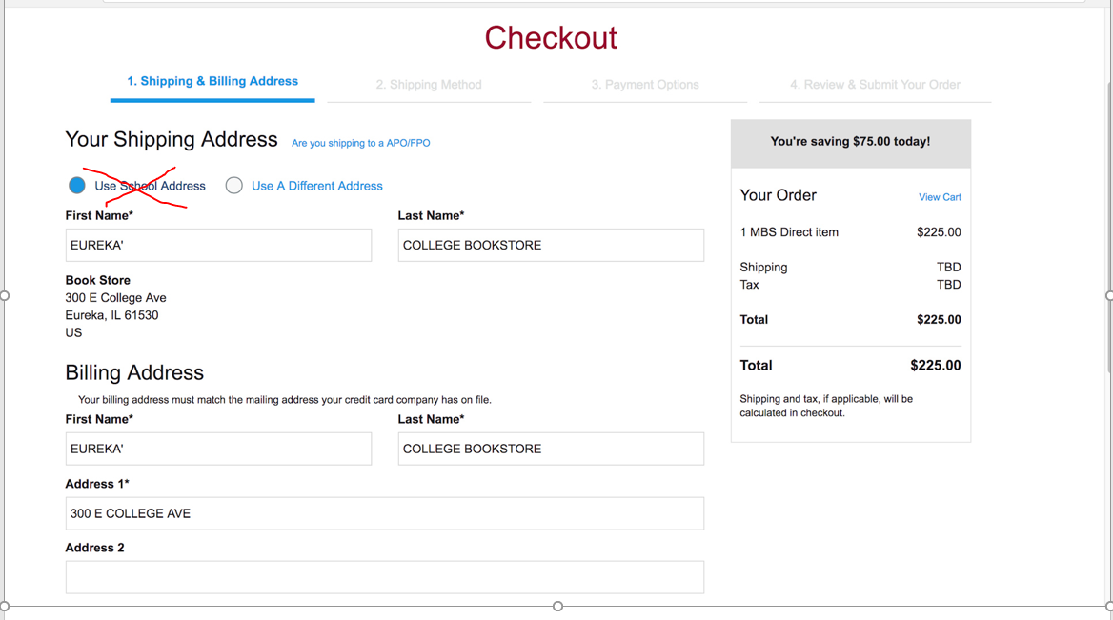

Slide 9
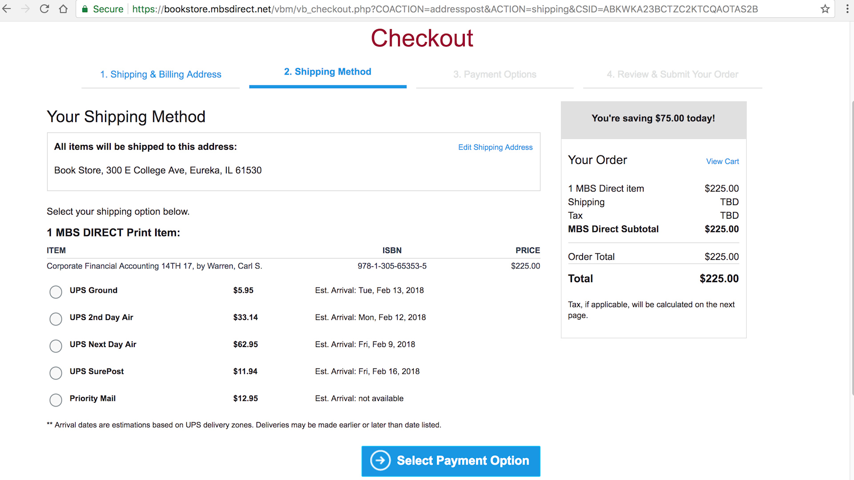

Slide 10
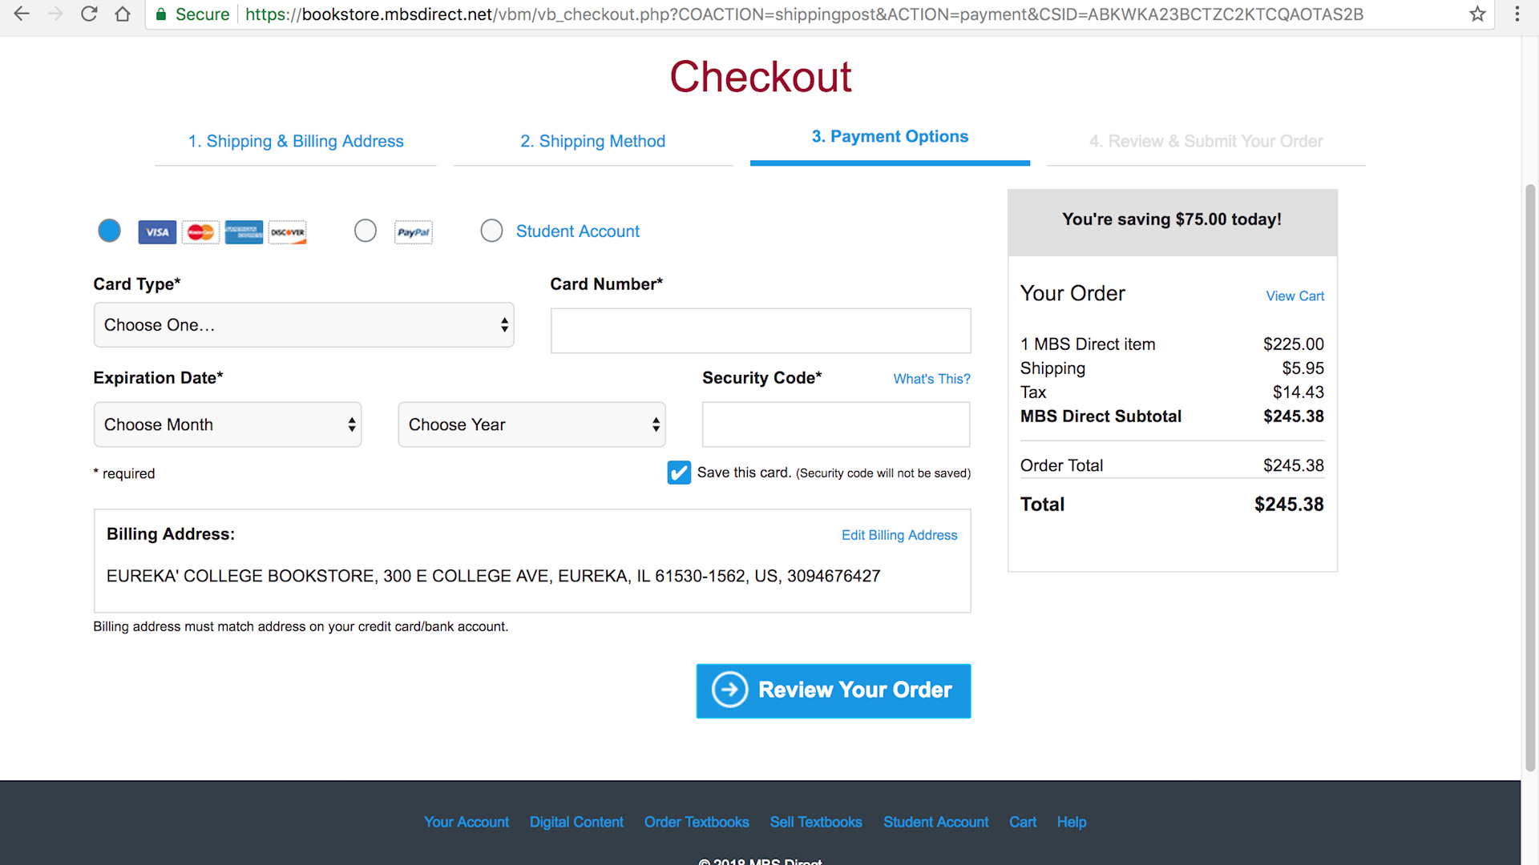

Slide 11
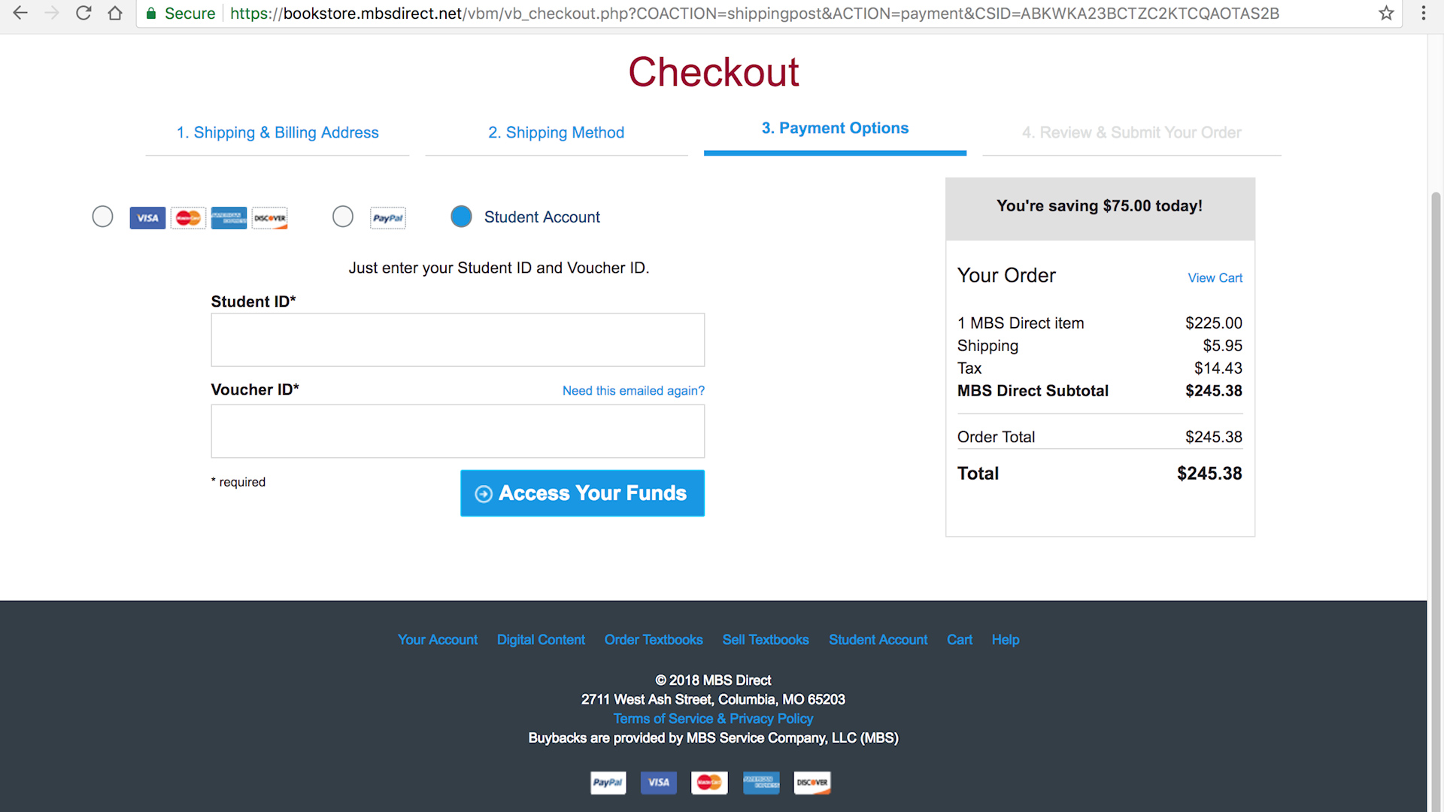

Slide 12
Questions?
bookstore@eureka.edu

