Slide 1
Vision ITQ Classroom Upgrade
Changes to earlier technology and upgrades

Slide 2
Every classroom that had a PC and projector has had some type of upgrade.
Every classroom that has a fixed instructors desk has the AMX controller.
The remaining seminar rooms that did not get an upgrade Jim Perry has access to projectors & laptops to service these needs

Slide 3
Tasks for Project and Work
Consolidate and make technology easier to use
  Access for Laptop use in the classroom – VGA/Sound cable top of desk
  Upgrade sound – Ceiling/Wall mounted speakers
  Make computers faster
    Better PCs
    Locked down PC to protect EC owned software installs & upgrades
  Heat issues – Mounted projector into “living space”
  Better controlled tech – controlled through AMX & projector
  Old technology (Overheads, slide projectors) – Elmo Digital Camera
  Brighter Projectors – Increased brightness by 200% or more - 4200 lum

Slide 4
Issue with PC or Login
Please call the number on the screen or on the small paper instructions with each desk
IT will take steps to repair or replace the issue but in the mean time
  Contact Jim Perry he has access to laptops that can be added to desktop until PC issue is resolved
  Laptops do not have BluRay Drives

Slide 5
Changes & Notes
BluRay was added
  CyberLink 13 added for BluRay discs
  PC, Projector & AMX must be on to cue up BluRay
  FF through previews can be done with mouse but to start BluRay you should hit the Enter key on the keyboard
Music/Internet Videos/Standard DVDs – must have projector on to hear sound, even though desk monitor is showing video
Do not save anything on the PC, PC is wiped when you log off
If you need any software added please contact IT so licensing can be verified & software added and PC locked back down
Logging into the EC network will give you access to network drives & printers in classrooms, but if the password is expired, no printing
Sound can be adjusted in three places – PC, Software, AMX controller

Slide 6
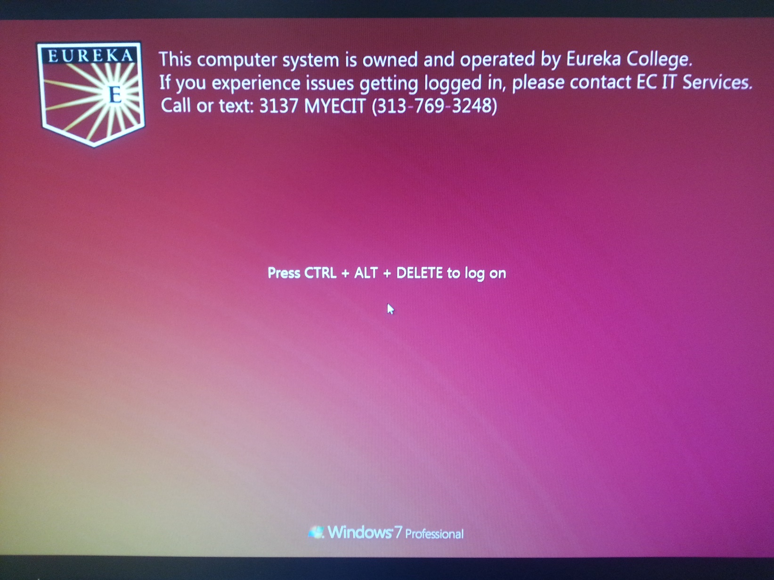
Look ☺ Windows 7: Startup and Login

Slide 7
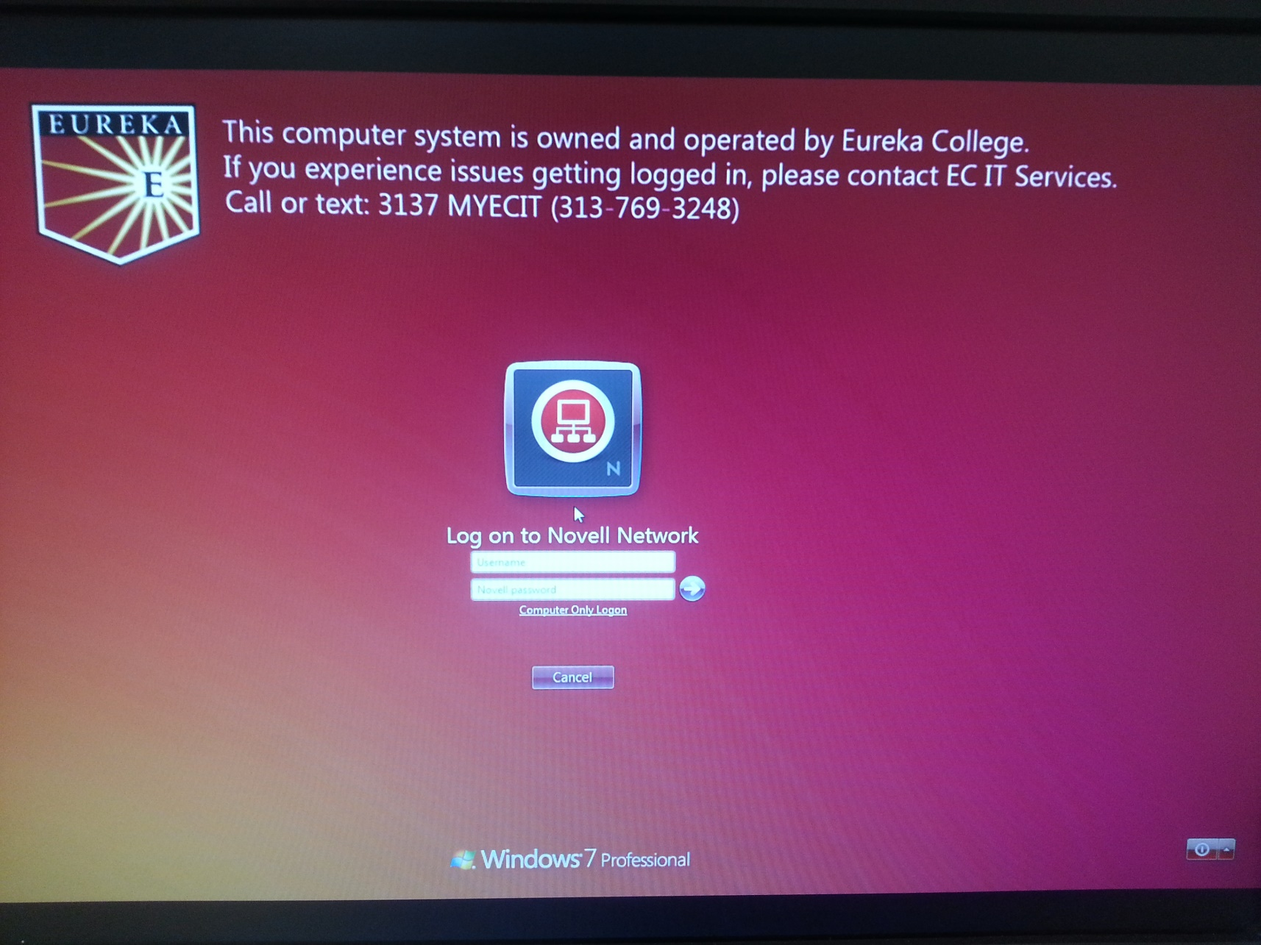
Windows 7: Startup and Login cont.

Slide 8
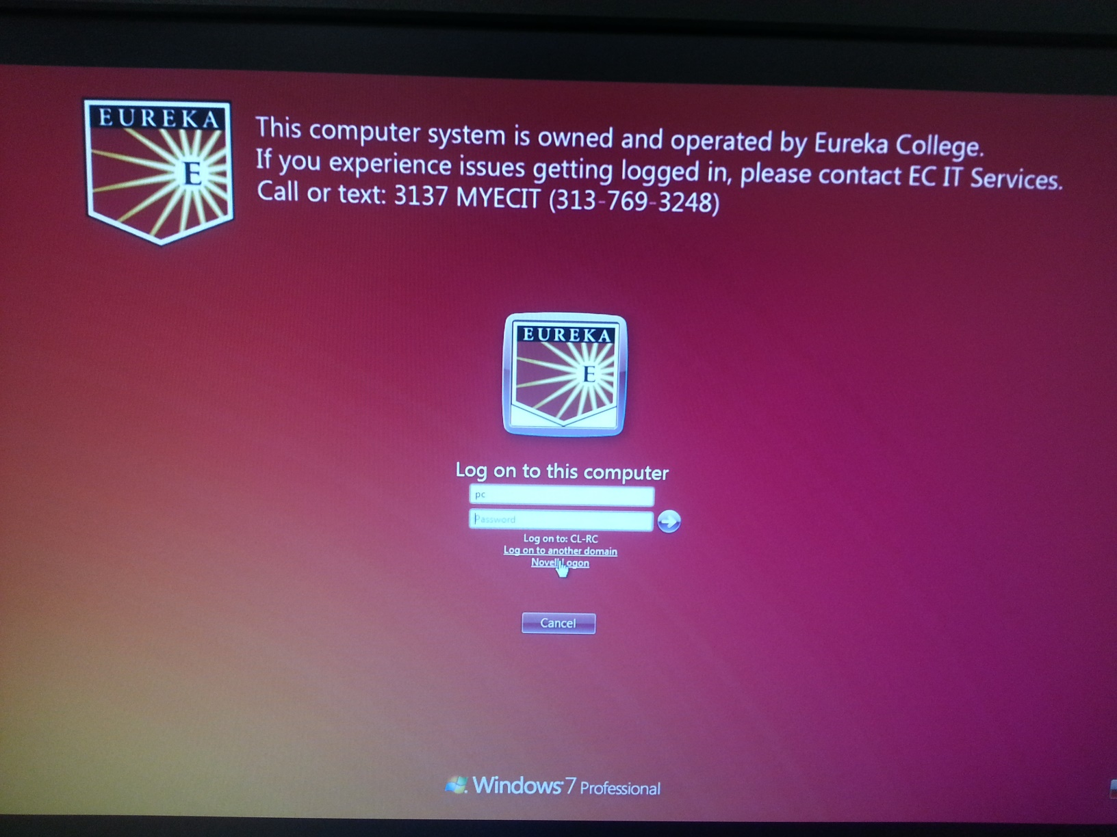
Windows 7: Startup and Login cont.

Slide 9
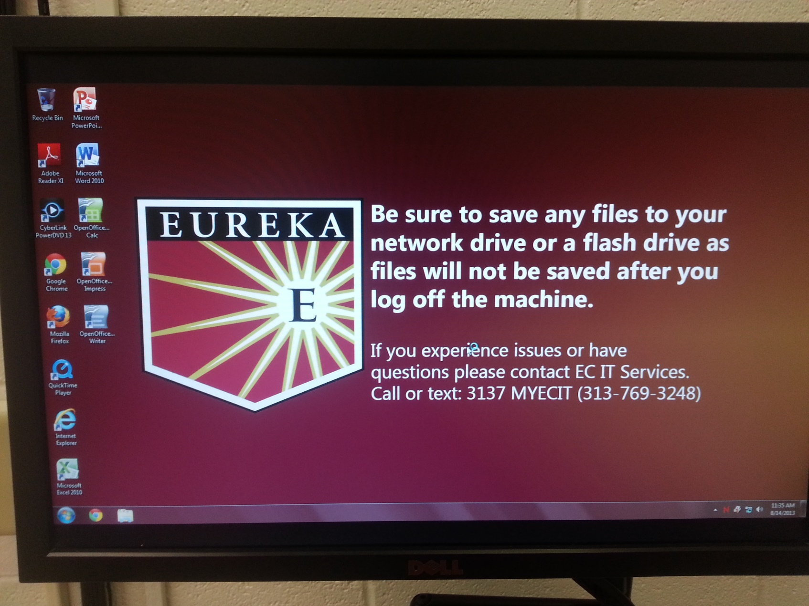
Windows 7: Startup and Login cont.

Slide 10
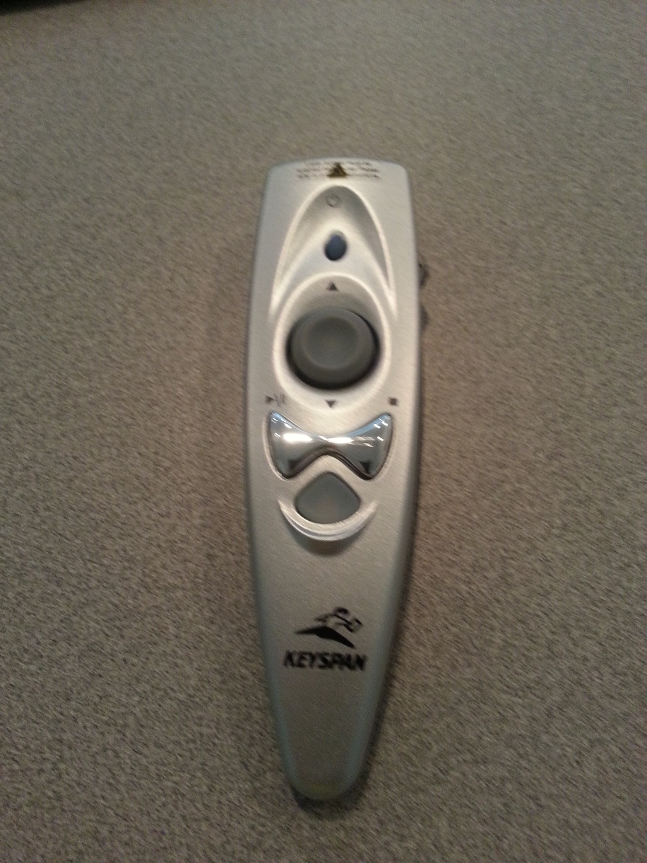
Keyspan Remote PowerPoint Wheel
The PowerPoint wheel located on the side of the remote advances or retreats the PowerPoint slides or actions in your show after it has been started.
PowerPoint Wheel

Slide 11
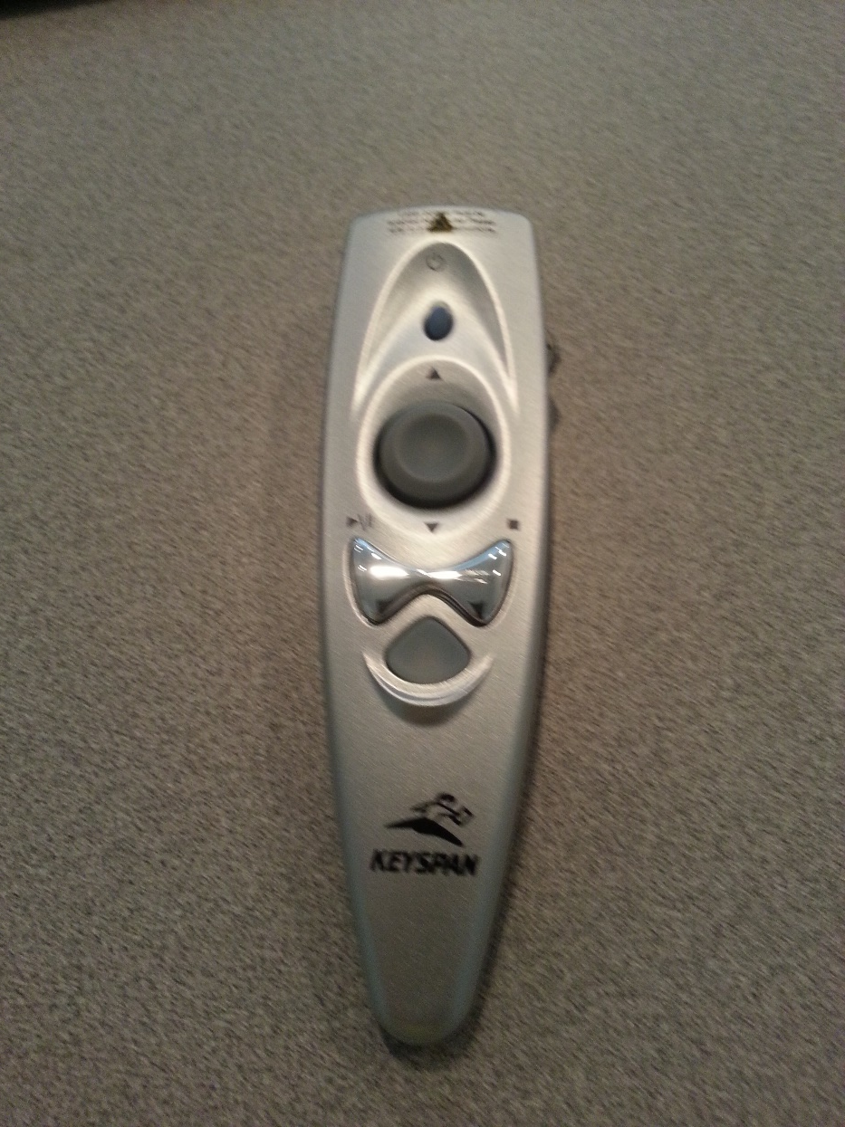
Keyspan Remote Laser Activation
Simultaneously press and hold the
laser button and the triangular button until the triangular button flashes red. To turn the laser off use the same technique.
The Laser button
The Triangular button

Slide 12
Requests
When classes are not being held in classrooms
  Please reserve the classroom if you need to use a classroom
    Please contact someone in SPS
  IT uses this time to update the PCs in the classrooms
    We do not want to start an upgrade & interrupt your plans

Slide 13
Thanks and Questions

